Slide 1

Counterfactual Multi-Agent Policy Gradients
AAAI’18
Presenter: Gyuseok Lee
Supporter: Jihoo Park
2022.09.22

Slide 2
Table of Contents
Introduction
Background
Method
Experiment
Quiz

Slide 3
Table of Contents
Introduction
Background
Method
Experiment
Quiz

Slide 4
Introduction
Problem
Problem1: RL methods typically design for single agents
→ Exponentially growing joint action space
Solution: Decentralized polices

Slide 5
Introduction
Problem
Problem2: Decentralized polices conditioned only on its local action-observation history

Slide 6
Introduction
Motivation
Great need for efficiently learning decentralized policy
Constraints
1) Centralized learning of decentralized policies
2) Multi-agent credit assignment

Slide 7
Introduction
Propose
Counterfactual multi-agent (COMA) policy gradients
Main Ideas
1) Centralized critic → Using joint action + all available state information
2) Counterfactual baseline → credit assignment
3) Critic representation → efficiently computing for counterfactual baseline

Slide 8
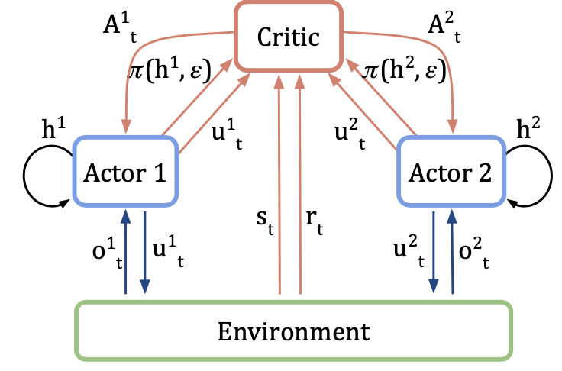
Introduction
COMA

Slide 9
Table of Contents
Introduction
Background
Method
Experiment
Quiz

Slide 10

Background
Cooperative Multi-agent task
Described as a stochastic game $G= <S,U,P,r,Z,O,n,γ>$
Notation
$S$ = States set (i.e., $s∈S)$
$U$ = Joint action set (i.e., $u^{a}∈U:an action choosen by agent a$)
$P$ = State transition function (i.e., $P\left(s^{′}\right|s,u) :S x U x S →\left[0,1\right])$
$r$ = Reward function (i.e., $r\left(s,u\right))$
$Z$ = Observation set (i.e., $z∈Z)$
$O$ = Observation function (i.e., $O\left(s,a\right):S x A →Z$)
$n$ = the number of agents , $γ$ = discount factor

Slide 11

Background
Single-Agent Policy Gradient Methods
Performing gradient ascent on estimation of expected discounted total reward:
$$g=E_{s_{0:∞},u_{0:∞}}[Σ_{t=0}^{T}R_{t}∇_{θ_{π}}logπ\left(u_{t } | s_{t }\right)]$$
→ $θ_{π}≔θ_{π}+α∙g$
Single agent policy:$θ_{π}$
Discounted reward: $R_{t}$ = $Σ_{l=0}^{T}γ^{l}r_{t+l}$

Slide 12

Background
Variations of $R_{t}$ for credit assignment
The credit assignment is used for measuring the contribution of each agent
1) Advantage Function
$A^{π}$($s_{t}$, $u_{t}$) = $Q^{π}$($s_{t}$, $u_{t}$) - $V^{π}$($s_{t}$)
2) Temporal difference (TD) Error
$r_{t}+γV$($s_{t+1})−V(s)$

Slide 13


Background
Variations of $R_{t}$ for credit assignment
The credit assignment is used for measuring the contribution of each agent
$$g=E_{s_{0:∞},u_{0:∞}}[Σ_{t=0}^{T}R_{t}∇_{θ_{π}}logπ\left(u_{t } | s_{t }\right)]$$
$$g=E_{s_{0:∞},u_{0:∞}}[Σ_{t=0}^{T}A^{π}\text{(}s_{t}\text{, }u_{t}\text{)}∇_{θ_{π}}logπ\left(u_{t } | s_{t }\right)]$$
OR
$$g=E_{s_{0:∞},u_{0:∞}}[Σ_{t=0}^{T}{(r}_{t}+γV\text{(}s_{t+1})−V(s))∇_{θ_{π}}logπ\left(u_{t } | s_{t }\right)]$$

Slide 14

Background
Independent Actor-Critic (IAC)
Based on Independent Q-learning (Tan, 1993)
Speedy learning by sharing parameters (e.g., one actor-critic is used by all agents)
Each agents behave differently based on local observation
Each agent’s critic estimates only a local value function
Condition on $u^{a}$ not $u$
Advantage function of IAC
$A(τ^{a},u^{a})$ = $Q(τ^{a},u^{a})$ – $V(τ^{a})$ (i.e., $τ^{a}$ = action-observation history)

Slide 15
Background
IAC’s Problems
Cause: Lack of information sharing
Problem1: Difficulty of learning coordinate strategies
Problem2: Difficulty of estimating the contribution of each agents
→ COMA deals with the problems efficiently

Slide 16
Table of Contents
Introduction
Background
Method
Experiment
Quiz

Slide 17
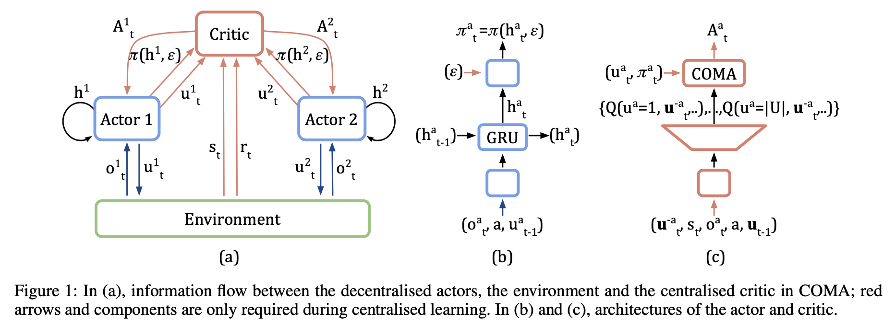
Method
Overall Structure for COMA

Slide 18
Method
Main Ideas of COMA
Centralized critic
Counterfactual baseline
Critic representation

Slide 19
Method
COMA
Idea1: Centralized critic → Using joint action + all available state information

Slide 20

Method
COMA
Idea2: Counterfactual baseline → credit assignment
Problems of Related Work
1) TD error Estimation:
→ Failing to address a key credit assignment problem
2) Difference rewards: $D^{a}$ = $r(s,u)$ – $r(s, \left(u^{−a}{,c}^{a}\right))$
→ Extra simulation & Difficulty of choosing default action (i.e., $c^{a}$)

Slide 21
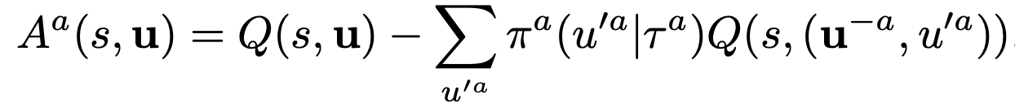


Method
COMA
Idea2: Counterfactual baseline → credit assignment
→ Marginalizing out $u^{a}$, while keeping the other agents’ actions $u^{−a}$
→ ${A^{a}(s,u}^{a})$ can computed when only agent $a$’s action changes
→ Do not need to extra simulation
$$g=E_{π}[Σ_{a}^{}A^{a}(s,u)∇_{θ_{π}}logπ\left(u_{t } | s_{t }\right)]$$

Slide 22

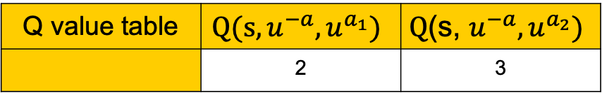
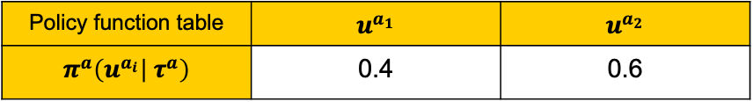
Numerical Example
EX1) Calculate (counterfactual) advantage function
$A^{a}\left(s,u\right)=Q\left(s,u\right)− \sum_{u^{a_{i}}}{π^{a}\left(u^{a_{i}} | τ^{a}\right)}Q(s,\text{(}u^{−a},u^{a_{i}})$)
* Assume that $Q\left(s,u\right)=3$
Policy function table | $$u^{a_{1}}$$ | $$u^{a_{2}}$$
$$π^{a}\left(u^{a_{i}} | τ^{a}\right)$$ | 0.4 | 0.6
Q value table | $$Q(s,u^{−a},u^{a_{1}})$$ | $$\text{Q}\text{(}\text{s}\text{, }u^{−a},u^{a_{2}})$$
 | 2 | 3

Slide 23

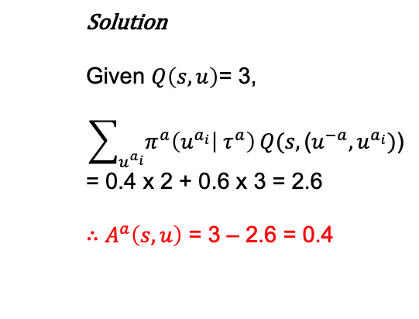
Numerical Example
EX1) Calculate advantage function
$A^{a}\left(s,u\right)=Q\left(s,u\right)− \sum_{u^{a_{i}}}{π^{a}\left(u^{a_{i}} | τ^{a}\right)}Q(s,\text{(}u^{−a},u^{a_{i}})$)
* Assume that $Q\left(s,u\right)=3$
Solution
Given $Q\left(s,u\right)$= 3,
$$\sum_{u^{a_{i}}}{π^{a}\left(u^{a_{i}} | τ^{a}\right)}Q(s,\text{(}u^{−a},u^{a_{i}})\text{)}$$
= 0.4 x 2 + 0.6 x 3 = 2.6
$∴$ $A^{a}\left(s,u\right)$ = 3 – 2.6 = 0.4
Policy function table | $$u^{a_{1}}$$ | $$u^{a_{2}}$$
$$π^{a}\left(u^{a_{i}} | τ^{a}\right)$$ | 0.4 | 0.6
Q value table | $$Q(s,u^{−a},u^{a_{1}})$$ | $$\text{Q}\text{(}\text{s}\text{, }u^{−a},u^{a_{2}})$$
 | 2 | 3

Slide 24

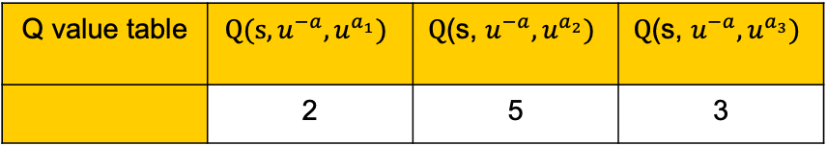
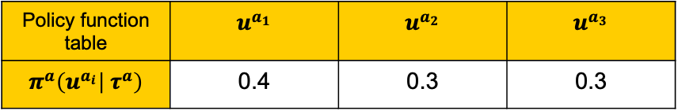
Numerical Example
EX2) Calculate advantage function
$A^{a}\left(s,u\right)=Q\left(s,u\right)− \sum_{u^{a_{i}}}{π^{a}\left(u^{a_{i}} | τ^{a}\right)}Q(s,\text{(}u^{−a},u^{a_{i}})$)
* Assume that $Q\left(s,u\right)=5$
Policy function table | $$u^{a_{1}}$$ | $$u^{a_{2}}$$ | $$u^{a_{3}}$$
$$π^{a}\left(u^{a_{i}} | τ^{a}\right)$$ | 0.4 | 0.3 | 0.3
Q value table | $$Q(s,u^{−a},u^{a_{1}})$$ | $$\text{Q}\text{(}\text{s}\text{, }u^{−a},u^{a_{2}})$$ | $$\text{Q}\text{(}\text{s}\text{, }u^{−a},u^{a_{3}})$$
 | 2 | 5 | 3

Slide 25
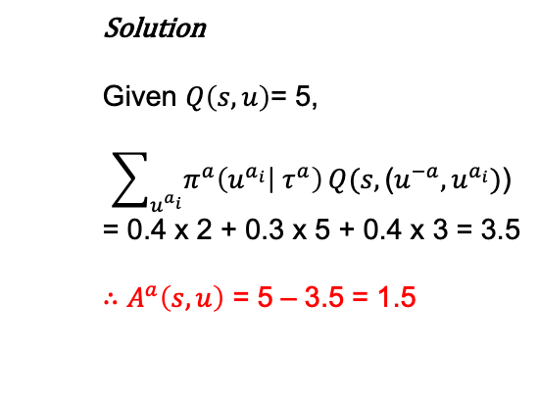

Numerical Example
EX2) Calculate advantage function
$A^{a}\left(s,u\right)=Q\left(s,u\right)− \sum_{u^{a_{i}}}{π^{a}\left(u^{a_{i}} | τ^{a}\right)}Q(s,\text{(}u^{−a},u^{a_{i}})$)
* Assume that $Q\left(s,u\right)=5$
Solution
Given $Q\left(s,u\right)$= 5,
$$\sum_{u^{a_{i}}}{π^{a}\left(u^{a_{i}} | τ^{a}\right)}Q(s,\text{(}u^{−a},u^{a_{i}})\text{)}$$
= 0.4 x 2 + 0.3 x 5 + 0.4 x 3 = 3.5
$∴$ $A^{a}\left(s,u\right)$ = 5 – 3.5 = 1.5
Policy function table | $$u^{a_{1}}$$ | $$u^{a_{2}}$$ | $$u^{a_{3}}$$
$$π^{a}\left(u^{a_{i}} | τ^{a}\right)$$ | 0.4 | 0.3 | 0.4
Q value table | $$Q(s,u^{−a},u^{a_{1}})$$ | $$\text{Q}\text{(}\text{s}\text{, }u^{−a},u^{a_{2}})$$ | $$\text{Q}\text{(}\text{s}\text{, }u^{−a},u^{a_{3}})$$
 | 2 | 5 | 3

Slide 26

Method
COMA
Idea3: Critic representation → efficient computing for counterfactual baseline
→ In a typical representation, the number of output nodes is ${|U|}^{n}$.
→ In COMA, the number of output nodes is $|U|$.
→ All Q-values for all agents can be computed in a single batched forward pass.

Slide 27
Table of Contents
Introduction
Background
Method
Experiment
Quiz

Slide 28
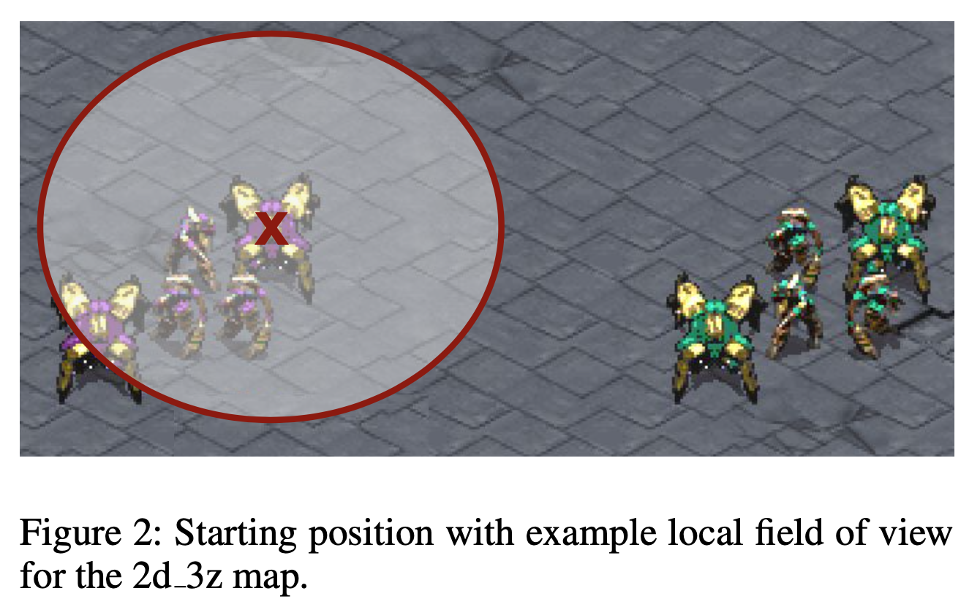
Experiment
Experimental Setup
Decentralized StarCraft Micromanagement
Ally units trained by COMA vs enemy controlled by StarCraft AI
Several scenarios: 3 marines (3m), 5 marines (5m), 5 wraiths (5w), 2 dragoons with 3 zealots(2d_3z)
Actor: 128-bit GRU
Critic: FC + ReLU layers

Slide 29
Experiment
Experiment Purposes
1) Does Centralized training really work?
baseline model: IAC-Q, IAC-V based on Independent Q-learning
2) Dose COMA baseline really work?
baseline model: Central-V (TD Error) , Central-QV (Advantage = Q - V)

Slide 30
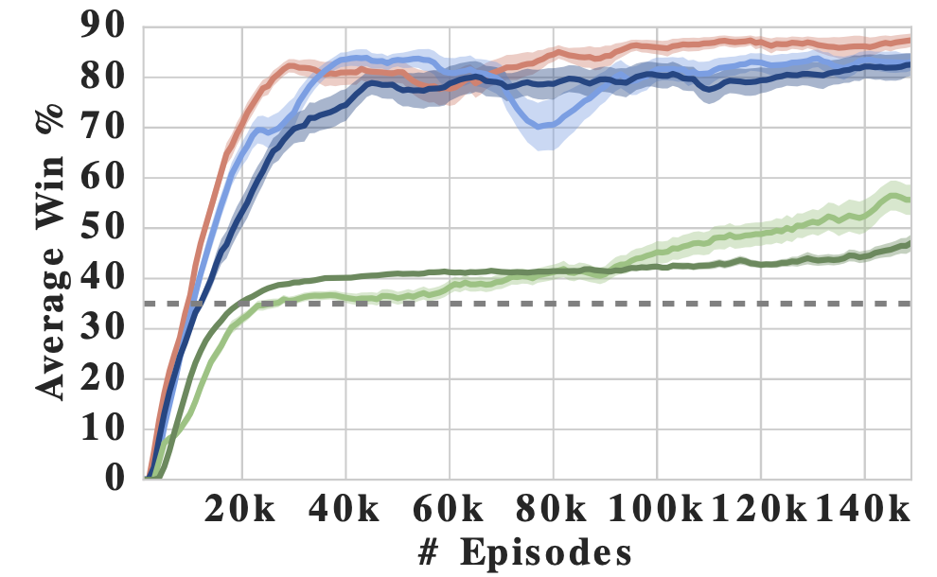

Experiment
Result1 (3 marines)

Slide 31
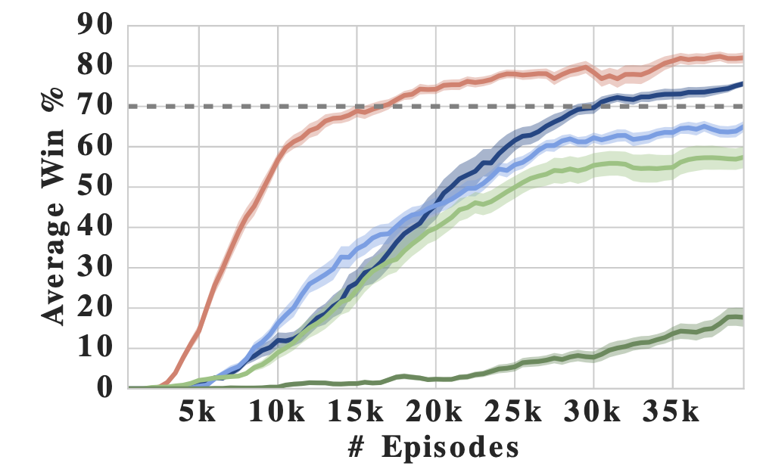
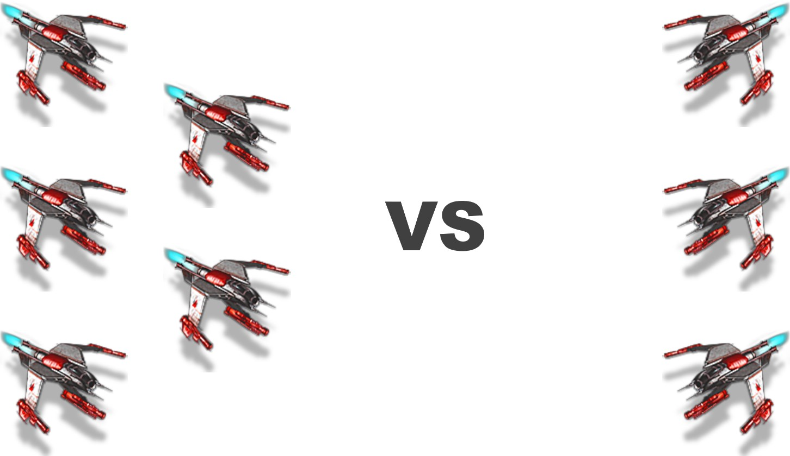
Experiment
Result2 (5 Wraiths)

Slide 32
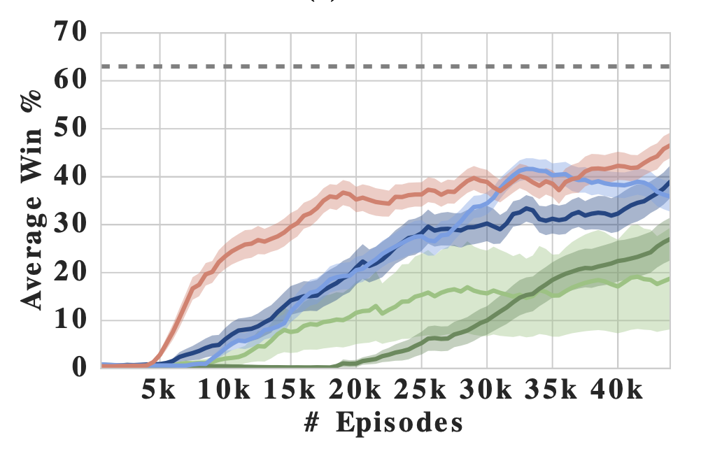
Experiment
Result3 (2 dragoons with 3 zealots)

Slide 33
Experiment
Result Summary
1) COMA is superior to IAC baselines
→ Centralized Learning is working well (i.e., Actor-Critic Structure)
2) COMA dominates central-QV or central-V
→ COMA baseline provides a shaped training signal (i.e., credit assignment)

Slide 34
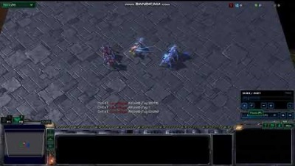
Experiment
Example
The team on the left is trained by COMA
Notes:
https://www.youtube.com/watch?v=QmruCZaB5yc

Slide 35
Table of Contents
Introduction
Background
Method
Experiment
Quiz

Slide 36

Quiz
Select the all true statements.
1) COMA doesn’t need to execute extra simulation for credit assignment.
2) Each agent in COMA shares the parameter for updating policy function.
3) Critic representations can reduce the computation for each agent by $|U|$.

Slide 37

Quiz
Select the all true statements. (True)
1) COMA doesn’t need to execute extra simulation for credit assignment.
2) Each agent in COMA shares the parameter for updating policy function.
3) Critic representations can reduce the computation for each agent by $|U|$.

Slide 38
Question?

Slide 39
Thank you

